Slide 1
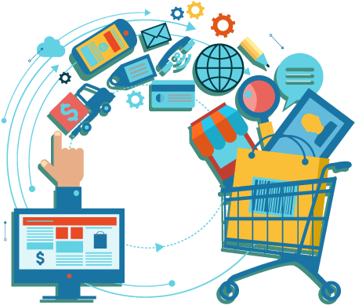
PRESENTATION ON
MARKET BASKET ANALYSIS
(USING RFM ANALYSIS)
Presented By:
Sushree Sangeeta Jena
PGDA27

Slide 2
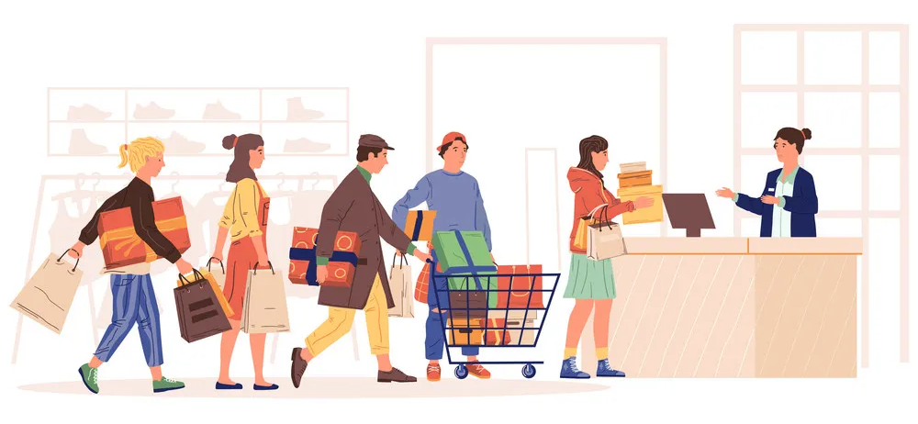
INTRODUCTION
CONTEXT:
UK Based and registered non-store online retail
Sells unique all occasion gifts
Transactional dataset between 1/12/2010 and 9/12/2011
PROBLEM STATEMENT:
Want to understand the value derived from customers
Because of competing markets, also want to retain customers with better services
GOAL:
Increase overall sales and profit
Improvise product recommendations

Slide 3

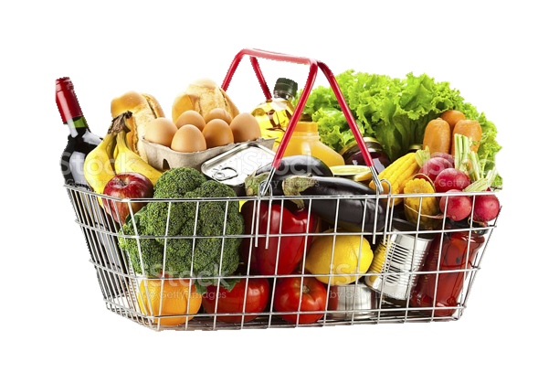

METHODOLOGY
Customer Transactions
Customer Segmentation
Market Basket Analysis
RFM Analysis
Kmeans Clustering
Apriori Algorithm

Slide 4
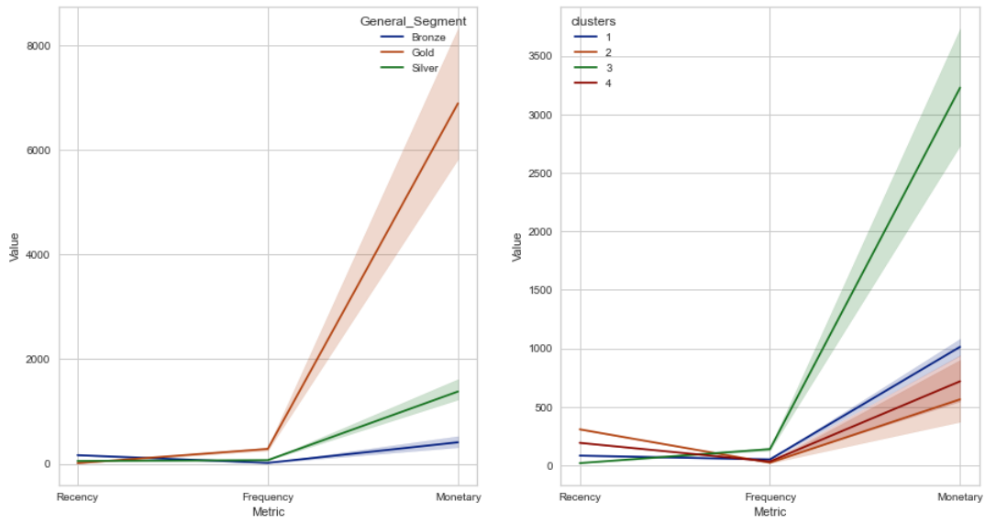
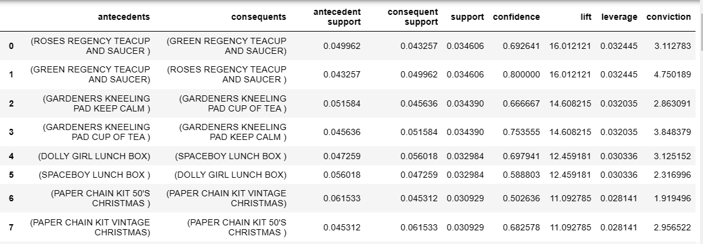
OBSERVATIONS

Slide 5
OBSERVATIONS
Results from RFM Analysis segmentation and Kmeans Clustering

Slide 6
OBSERVATIONS

Slide 7
OBSERVATIONS
Association between products using Apriori algorithm

Slide 8
OBSERVATIONS

Slide 9
KEY FINDINGS
01
RFM Analysis and Kmeans Clustering help in customer segmentation thereby helping us to make business strategies
02
Customers with lower recency, higher frequency and monetary are the ones with higher RFM scores and are the premier customers
03
Apriori Algorithm works better for large datasets and help us to find the association between two products
04
Apriori Algorithm helps in product recommendation, increase revenues, customer retention, etc

Slide 10
FUTURE SCOPE
01
Apriori Algorithm can be used for Silver and Bronze segment to understand their purchasing behaviour
02
We can conduct analysis based on the countries to understand the customer purchase
03
Item Based Collaborative Filtering can also be considered to recommend products and comparison can be made between the algorithms

Slide 11
THANK YOU

